Slide 1
Regular Expressions

Slide 2
Problem 1
With regular expressions, you don’t need to know what exactly you want to find.
What you should know is a rough idea about what that you are trying to find looks like.
Q: I want to find if a digit is present in a string.
A:
[] Represents a class of characters.
[0-9] Represents a class of the 10 digits.
You can find a digit by iterating over range(0, 10) and find it a digit is present in a string.
Or, you can tell the computer that if you find any digit from 0 to 9, then let me know.
Which is better?
The solution using range() looks simple but it is elegant enough.
The more Pythonic solution is when we would tell the computer that give me the character that matches the class of digits, i.e., [0-9].

Slide 3
In Code
import re
str_1 = "Hi, my name is Johanth!"
str_2 = "I am 13 years old."
str_3 = "You can reach me at 9876543210."
str_4 = "You can email me at johanthyada@gmail.com"
l = [str_1, str_2, str_3, str_4]
for i in l:
x = re.search('[0-9]', i)
if x:
print(i, ": Found at :", x.span(), ": Found what :", x.group())
Output:
I am 13 years old. : Found at : (5, 6) : Found what : 1
You can reach me at 9876543210. : Found at : (20, 21) : Found what : 9

Slide 4
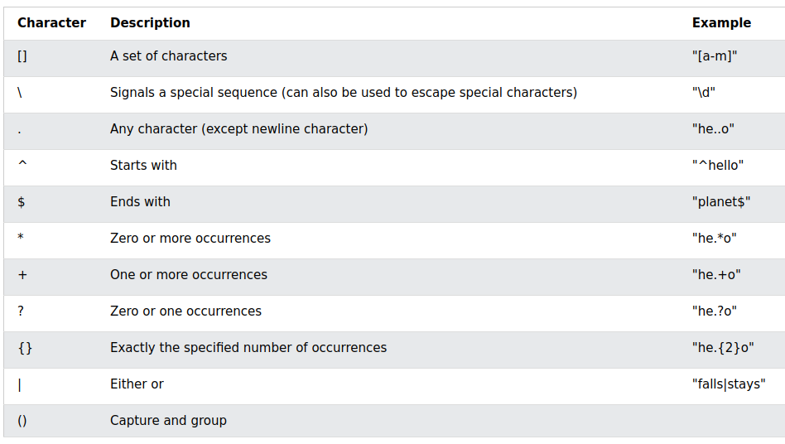

Slide 5
Problem
We want a pattern for looking up a 10 digit phone number:
[0-9]: How many characters does this pattern contain?
Ans: One character and it could be any number between 0-9
[0-9]* : It would match a phone number but it would also match these “9”, “123”, “123456789012345”.
[0-9]{10}:
"hello 7696499407 123 1234567890123"
Picks up ['7696499407', '1234567890']
Do we have a solution here?
Ans: Using “Capture and Group”
x = re.findall("([0-9]{10}) ", txt)

Slide 6
Problem 2: Replacing nested for-loops with Regex
Ques: I want to find if a special character from (, ! . + @) is present in a list of strings.
Ans:
If we were to do this using for-loop, we would two for-loops.
Important Note: nested loops take a lot of time in comparison to one-liner solutions.
import re
str_1 = "Hi, my name is Johanth! Nice to meet you."
str_2 = "I am 13 years old. And you?"
str_3 = "You can reach me at +91 9876543210."
str_4 = "You can email me at johanthyada@gmail.com"
l = [str_1, str_2, str_3, str_4]
m = ['!', '?', '+', '@']
for x in l:
for y in m:
if x.find(y) != -1:
print(x)
print("Found", y, "at : ", x.find(y))
Hi, my name is Johanth! Nice to meet you.
Found ! at : 22
I am 13 years old. And you?
Found ? at : 26
You can reach me at +91 9876543210.
Found + at : 20
You can email me at johanthyada@gmail.com
Found @ at : 31

Slide 7
Solution
""" Ques: I want to find if a special character from (, ! ? . + @) is present in a string.
Ans: """
import re
str_1 = "Hi, my name is Johanth! Nice to meet you."
str_2 = "I am 13 years old. And you?"
str_3 = "You can reach me at +91 9876543210."
str_4 = "You can email me at johanthyada@gmail.com"
l = [str_1, str_2, str_3, str_4]
for x in l:
y = re.search("[!?+@]", x)
if y:
print(x)
print("Found at :", y.span(), ": Found what :", y.group())
Hi, my name is Johanth! Nice to meet you.
Found at : (22, 23) : Found what : !
I am 13 years old. And you?
Found at : (26, 27) : Found what : ?
You can reach me at +91 9876543210.
Found at : (20, 21) : Found what : +
You can email me at johanthyada@gmail.com
Found at : (31, 32) : Found what : @

Slide 8
Problem 3
Q: There is list of strings. The strings is a sequence of numbers with one alphabet in between.
You task is to find that alphabet.

Slide 9
Solution
import re
import random
import string
# Randomly choose a letter from all the ascii_letters
l = []
for i in range(20):
x = [str(random.randint(0,9)) for j in range(10)]
x[random.randint(0,9)] = random.choice(string.ascii_letters)
l.append(''.join(x))
print(l)
""" Homework:
Find the alphabets in a list of numerical strings using Regex.
['496d665979', '772T202957', '23650784J3', '4252925k32', '72733Q8098', '464W826820', '5990A42505', '4725V73478', '77148363L1', '3W15107781', 'Q088253588', '2660g58899', '81719893v3', '35s1605748', '442139N477', 'O724424959', '4E06284727', '160804Q000', '8726r38255', '1b38353340'] """
for i in l:
x = re.search('[a-zA-Z]', i)
if x:
print(i, ": Found at :", x.span(), ": Found what :", x.group())

